Slide 1
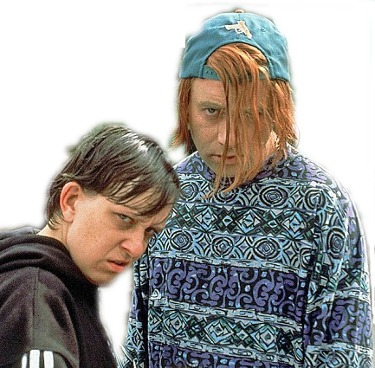
Teenage Problems

Slide 2

Introduction
“ You and three partners are going to have a discussion in front of the class
about typical teenage problems.”

Slide 3

“I’ll be back by
eleven, Mum.
I promise.”

Slide 4

“You’re not
wearing that!”
Introduction
“ You and three partners are going to have a discussion in front of the class about typical teenage problems.”

Slide 5
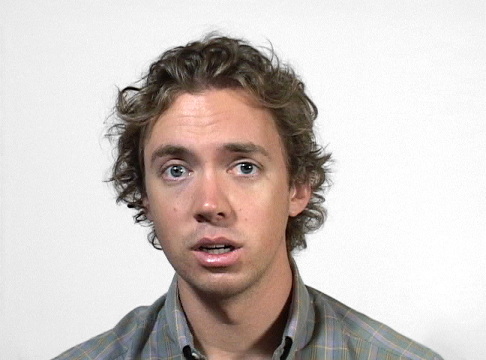
“Dad. Can
I play
Call of Duty?”

Slide 6

NO!

Slide 7



You’re not going
out this weekend.
You’ve got to study.

Slide 8
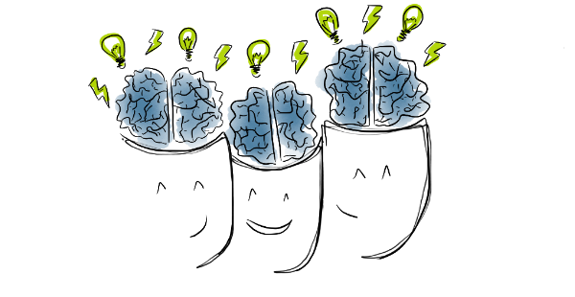
Task 1
Teenage Problems Brainstorming
Brainstorm and discuss
your ideas
as a class.

Slide 9


Task 2
Take a note of target
language

Slide 10
TARGET LANGUAGE
Giving Advice
How about... ?
Why not... ?
Why don't you... ?
You could...
You should...

Slide 11

TARGET LANGUAGE
Expressing you opinion
Well, I think that...
In my opinion...
The first thing I want to say is that...
The main problem is ...
The best/worst/important thing about ...

Slide 12
TARGET LANGUAGE
Agreeing
Exactly!
I agree with you. You’ve got a point. I suppose you’re right.

Slide 13
TARGET LANGUAGE
Disagreeing
I see your point but I don’t agree.
I’m sorry but I disagree. You’re completely wrong. That’s ridiculous!

Slide 14

TARGET LANGUAGE
Turn-taking
Peter, do you agree with Jane.
Albert, would you like to add anything?
Ana, what do you think about this?

Slide 15
TARGET LANGUAGE
Clarifying people’s opinions
What do you mean exactly?
Could you explain that again, please?

Slide 16
TARGET LANGUAGE
Interrupting politely
Can I just say something?
Can I interrupt for one second?

Slide 17
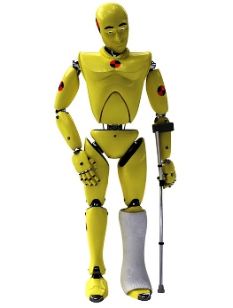

Task 3
The Dummy Run
Form groups of four.
Practise discussing the following teenage problems.
A group comes to the front of the class and practises discussing teenage problems with the teachers’ help.
Students need to use the target language to do well.

Slide 18


Teenage Problems 1-3
1. Teenagers treating their parents badly.
It is very common for teenagers to start being rude to their parents and
very unaffectionate. Please advise.
2. Teens get addicted to social networks, Whatsapp etc.
As a result, teenagers communicate less with the people
they live with i.e. younger siblings and their parents.
3. Staying out too late
The teen was supposed to be home by 10:30 pm but
keeps coming back at 11pm.

Slide 19



Teenage Problems 4-6
4. Hanging out with awful kids.
The teen is going out with bad kids who might smoke
and be a bad influence.
5. Piercings and weird clothes
The teen wants a piecing in their nose and
starts wearing black clothes.
6. Everything's a drama
The teen gets very angry over little things or cries and
goes into hysterics over nothing.

Slide 20

Teenage Problems 7-9
7. Computer games and never doing any exercise.
The teen spends 7 hours day on Saturdays playing Call of Duty and eating fuet and Bocabits.
8. Unhappy with appearance
Despite being a nice-looking teen, they are convinced
they are unattractive.
9. Failing too many subjects
The teen has failed 6 subjects in the autumn term.

Slide 21
Evaluation
1. COMMUNICATIVE LINGUISTIC COMPETENCE
1.1 Fluency/Pronunciation /1
1.2 Accuracy /2
1.3 Expressing opinions /2
1.4 Agreeing/Disagreeing /1
1.5 Turn-taking / 1
1.6 Interrupting politely /1
1.7 Clarifying opinions /1
1.8 Preparedness/1
TOTAL / 10

