Slide 1
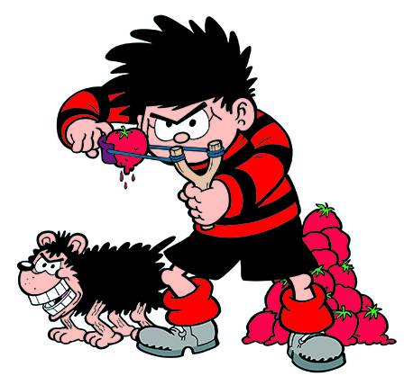
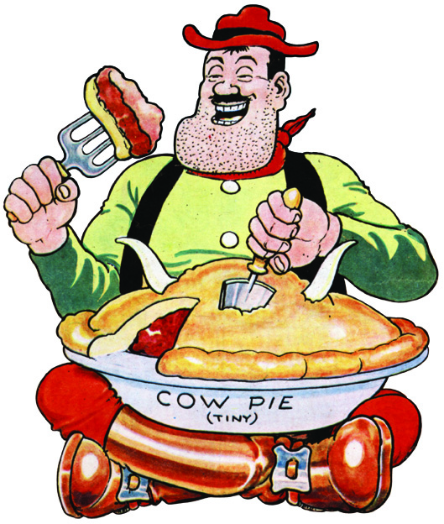
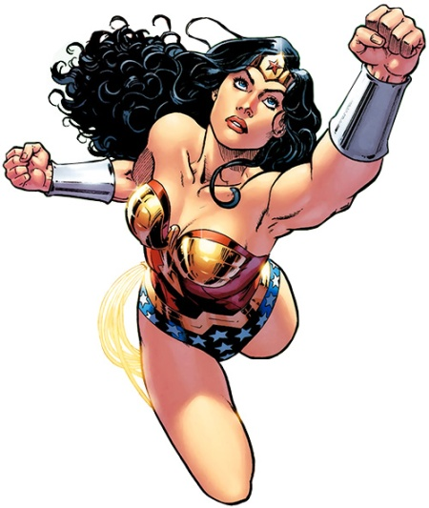
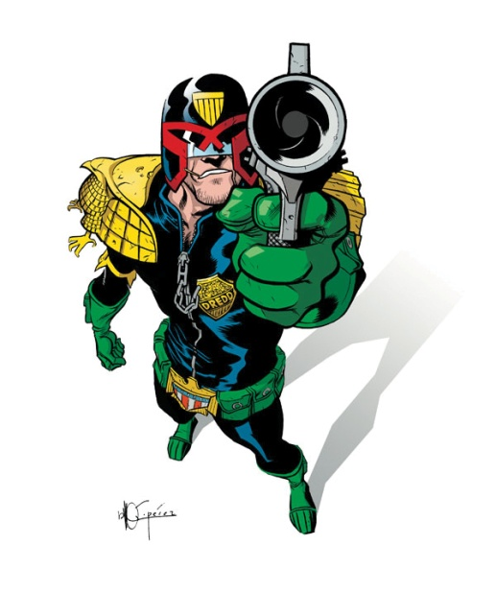
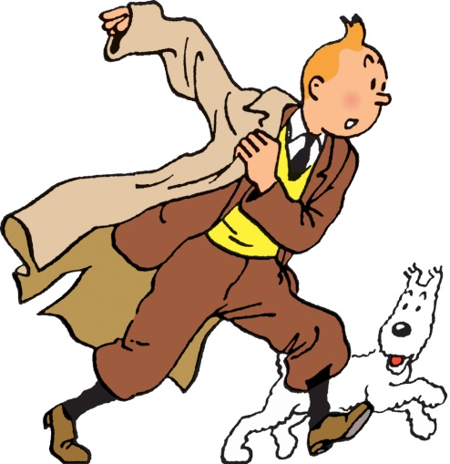
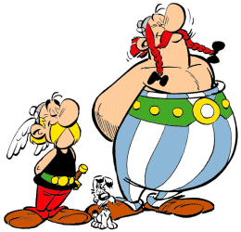
Make
a
Comic
Dennis the Menace from the Beano
Desperate Dan from the Dandy
Tintin by Hergé
Asterix the Gaul
Wonder Woman
Judge Dredd

Slide 2
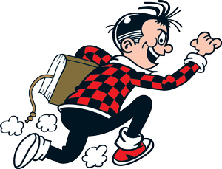
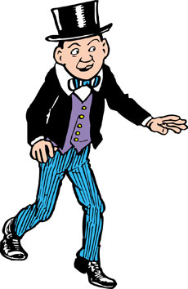
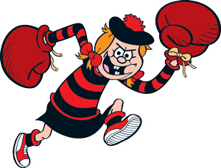
Introduction
In groups of three, you are going to make a comic.
Roger the Dodger
Minnie the Minx
Lord Snooty

Slide 3
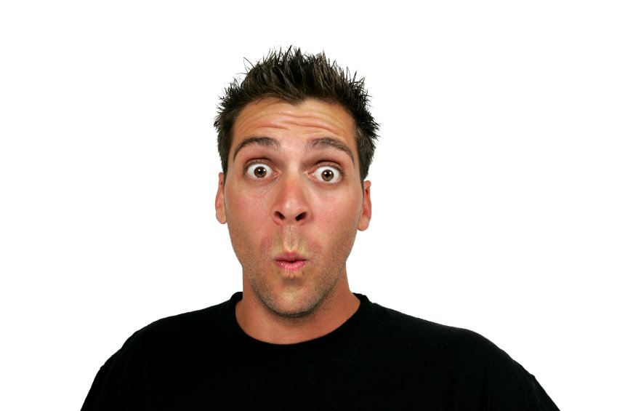
Introduction
In groups of three, you are going to make a comic.
HOW?!

Slide 4






Use these:
Speech bubbles
Thought bubbles
Exclamations
Sound effects
Narration box

Slide 5

I’ve got an idea.
Brad lives in New York.
What are you doing?
Why is he looking at me?
Look out!
She arrived home at midnight.

Slide 6
I’ve got an idea.
Brad lives in New York.
Present Simple
What are you doing?
Why is he looking at me?
Look out!
She arrived home at midnight.

Slide 7
I’ve got an idea.
Brad lives in New York.
Present Simple
What are you doing?
Why is he looking at me?
Present Continuous
Look out!
She arrived home at midnight.

Slide 8
I’ve got an idea.
Brad lives in New York.
Present Simple
What are you doing?
Why is he looking at me?
Present Continuous
Look out!
She arrived home at midnight.
Imperative/Orders

Slide 9
I’ve got an idea.
Brad lives in New York.
Present Simple
What are you doing?
Why is he looking at me?
Present Continuous
Look out!
She arrived home at midnight.
Past Simple
Imperative/Orders

Slide 10




Special Effects

Slide 11
Next:

Slide 12
Next:
Make up the characters

Slide 13
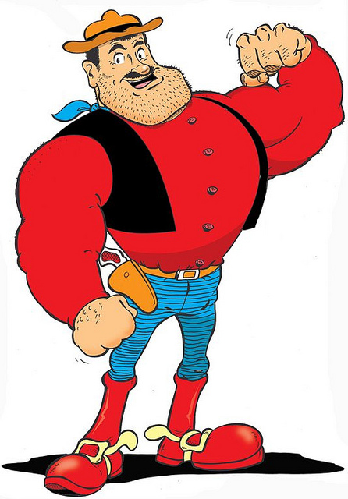

Make up the characters
What do they look like?
What do they wear?

Slide 14
What do they eat?

Slide 15
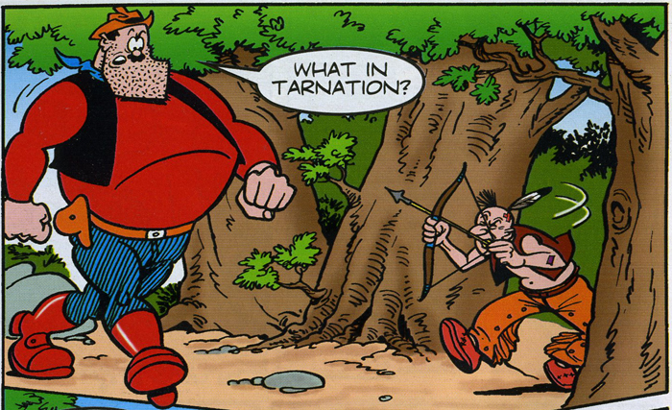
How do they speak?

Slide 16
Next:

Slide 17
Next:
Make up the story.

Slide 18
Next:
What happens?

Slide 19
Next:
What happens?
1. Introduction.
2. A problem.
3. Resolving the problem.

Slide 20
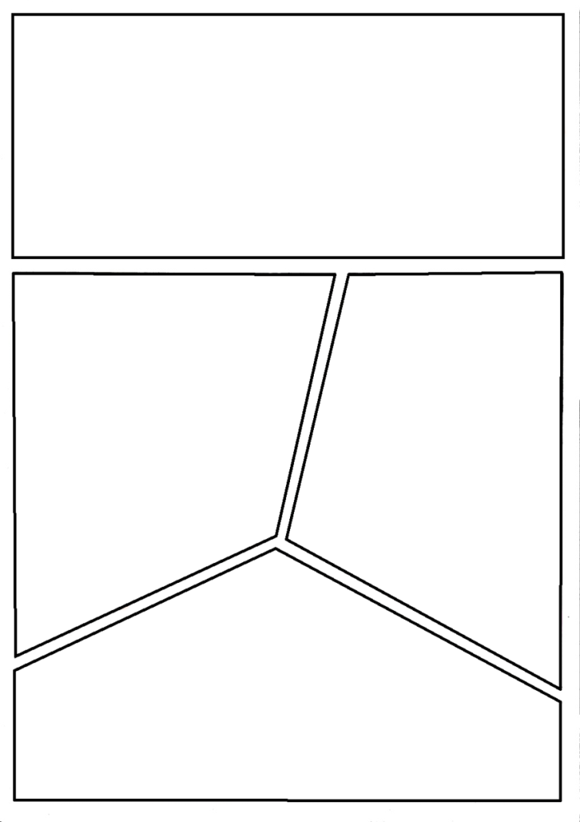
Next:
Design your pages.

Slide 21
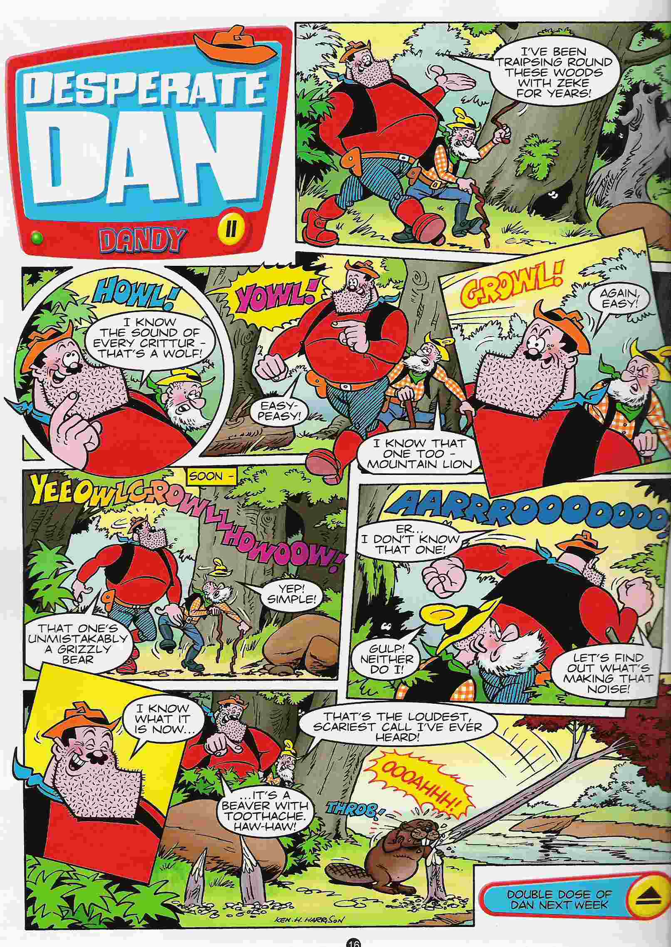

Slide 22
and make your comic.

Slide 23
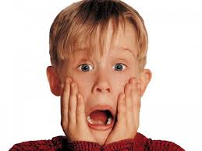
When you’ve finished
your comic, you have to
act it out in front of the class.

Slide 24
