Slide 1
QUICK GUIDE TO
SLIDE DESIGN

Slide 2
3 RULES
1. Fantastic images
2. Minimum text
3. Spell check

Slide 3
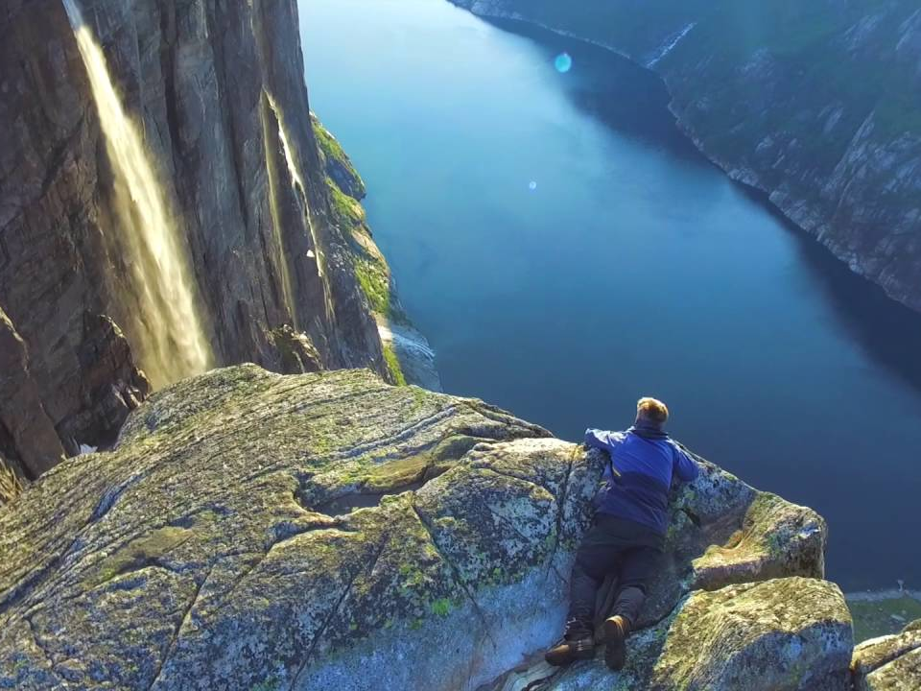

Slide 4
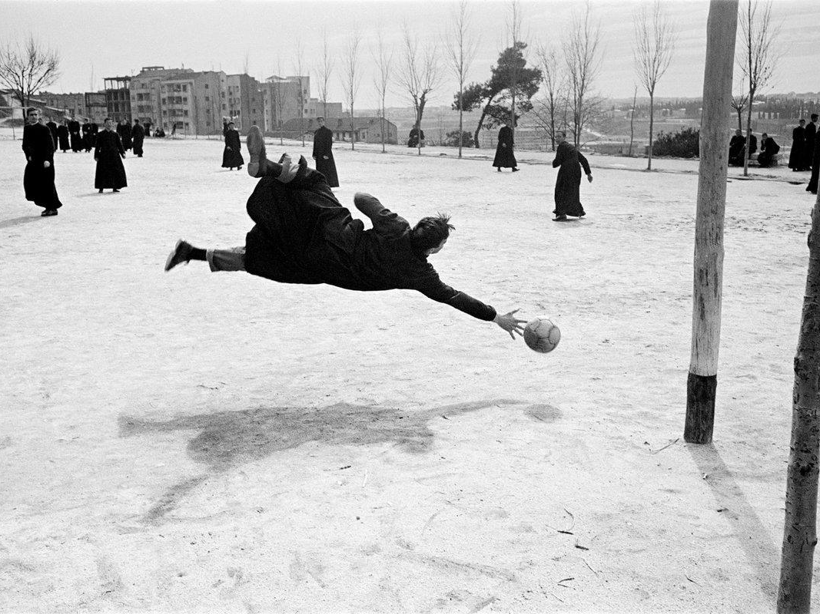

Slide 5
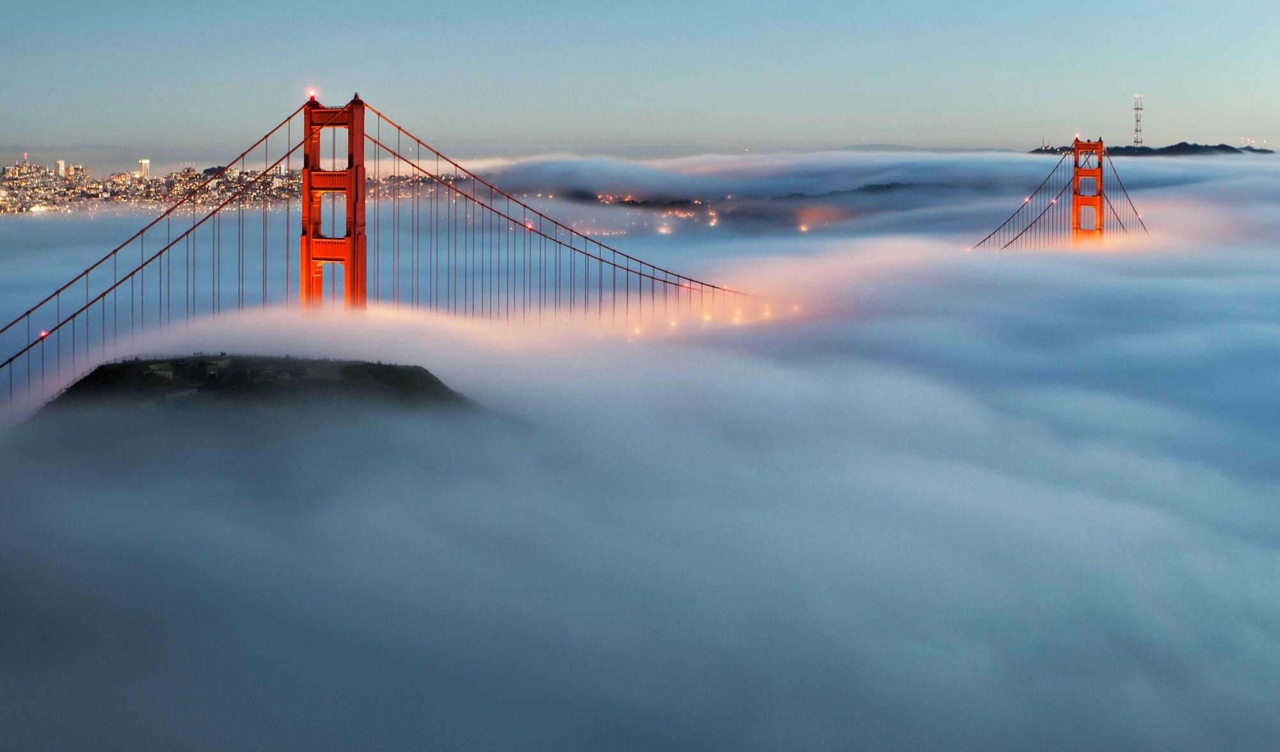

Slide 6
Why use great images?

Slide 7
Why use great images?
To attract & keep
people’s attention.

Slide 8
Garbage or Awesome?

Slide 13
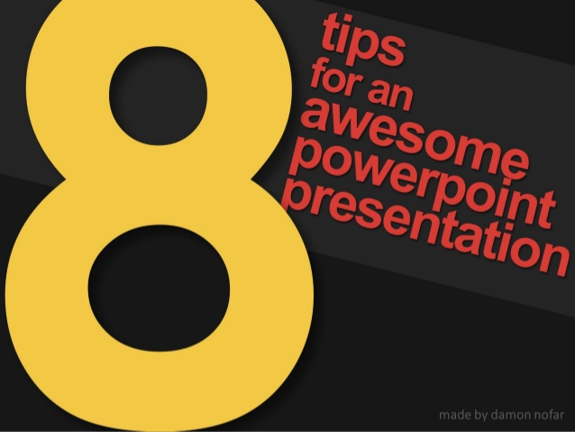

Slide 14
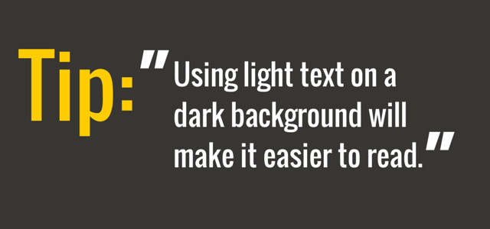

Slide 17
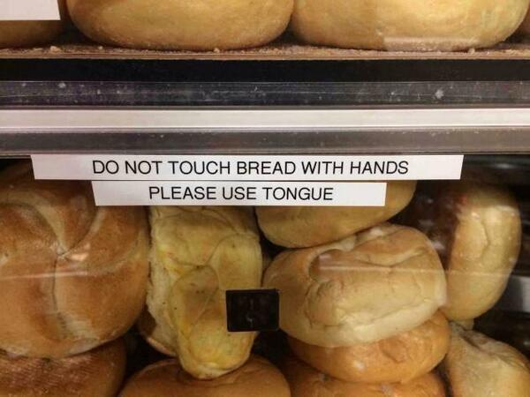

Slide 18
