Slide 1

PROJECT:
Making a Presentation
on Personality Types
& Learning Styles

Slide 2

CONTENTS
1. Learning styles questionnaire
2. Teams and roles
3. Choosing a topic
4. Interesting videos

Slide 3

1. Learning styles questionnaire
Download the questionnaire from autoenglish.org/pbl.com to find out your roles
learning styles questionnaire

Slide 4
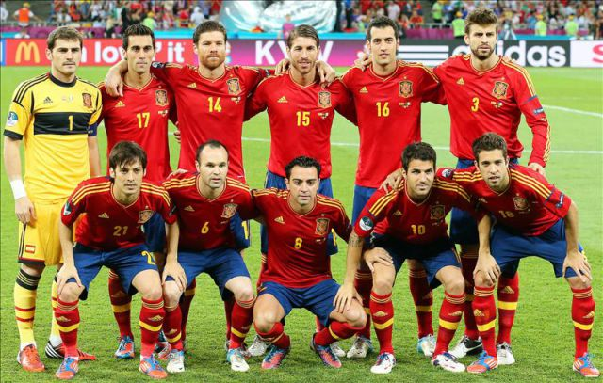
2. Teams and roles

Slide 5
2. Teams and roles
Teams consist of:
1. Four people
2. Two girls and two boys
3. Two extrovert style learners
4. Two introvert style learners

Slide 6


ROLES
The 4 roles are:
The EXPERT = Introvert style learner
The COMMUNICATOR = Extrovert with good English
The COORDINATOR = Extrovert style learner
The PRODUCER
= Introvert with good English

Slide 7
The Cell for Success
Zone of Shared Responsibility
Coordinator
Expert
Heijunka
Hansei
“even workload”
“Perpetual reflexion”
EXTROVERT
INTROVERT
Resolves conflicts
Communicator
Computer skills
Makes decisions
Genchi genbutsu
Research
Listens
“Go and see”
EXTROVERT
Shares info
Constant updates
Producer
Producer
Nemawashi
“Fast implementaton”
INTROVERT
Makes it happen
Meets deadlines

Slide 8
Personal Responsibilities
The Expert (Introvert style learner) :
questionnaire + slide design;
data analysis + graphs; apps
The Producer (Introvert with good English)
correcting ALL English mistakes
in questionnaire, slides etc
The Coordinator (Extrovert learner) :
meeting all DEADLINES; making
sure everyone does their part
The Communicator (Extrovert with good English)
communicating with students +
teachers; dropbox

Slide 9
2. Choosing a topic

Slide 10
The subject of your project is…

Slide 11
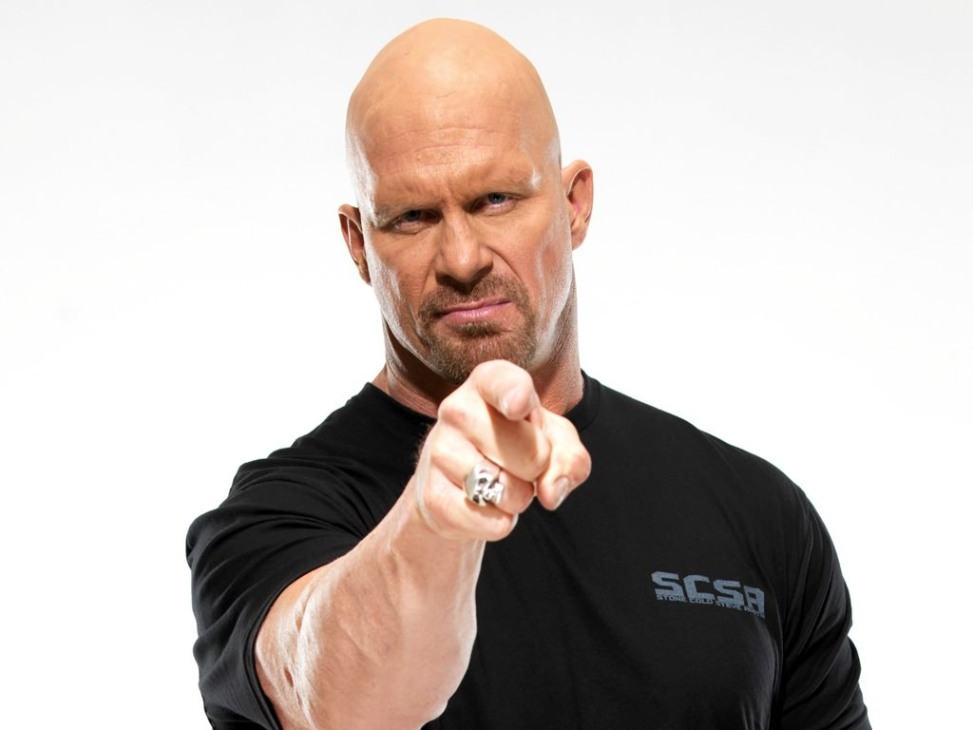
The subject of your topic is…

Slide 12


Slide 13
Just who are you exactly?

Slide 14
How do we get to know ourselves better?

Slide 15

For your project you will need to do:
RESEARCH
And prepare an awesome
PRESENTATION

Slide 16
RESEARCH ONE OF THE FOLLOWING TOPICS TO HELP YOU FIND OUT MORE ABOUT YOURSELF.

Slide 17
Visual, auditive or kinesthetic?
Emotional intelligence
Multiple intelligences
Style and tastes
Dreams and ambitions
Social skills
Self-confidence
Self-awareness
Creativity
Movies, books n’ music

Slide 18






Other Tasks:
Open a dropbox account.
Download the dropbox app to your smart phone.
Create a Whatsapp group for your team.

Slide 19

ASSESSMENT CRITERIA
Presentation design 20%
Oratory skills 20%
Accuracy 20%
Ability to talk about your work 20%
Skills related to your faction 20%

Slide 20
In the next class:
Show your apps to the teacher
Work out your choice of topic with your team

Slide 21
4. Watch these videos

Slide 22
Listen to Sir Ken Robinson, an expert in education.
https://youtu.be/Z78aaeJR8no
Jot down some ideas as you are listening

Slide 23
AFTER VIEWING
What points did you pick up from the talk?
What points do you agree or disagree with?
Why is creativity important?

Slide 24
Emotional Intelligence
Watch this video and note down the main points
https://youtu.be/MepJp7KpaH4
What’s difficult about being emotionally intelligent?
Why is it important?

Slide 25

Self-confidence
What is self-confidence?
Watch this
https://youtu.be/Ib6UB5_4vZg
How can you increase your self-confidence?

Slide 26
And here’s another talk about self-confidence.
https://youtu.be/w-HYZv6HzAs
Jot down some ideas as you are listening
Discuss as a class.

Slide 27
OK. LET’S GET
STARTED.

