Slide 1
Critical Thinking
Role Plays

Slide 2
The World Economic Forum:
The 3 top skills young people need to get a good job in 2020 are:
Complex problem solving
Critical thinking
Creativity
https://www.weforum.org/agenda/2016/01/the-10-skills-you-need-to-thrive-in-the-fourth-industrial-revolution/

Slide 3
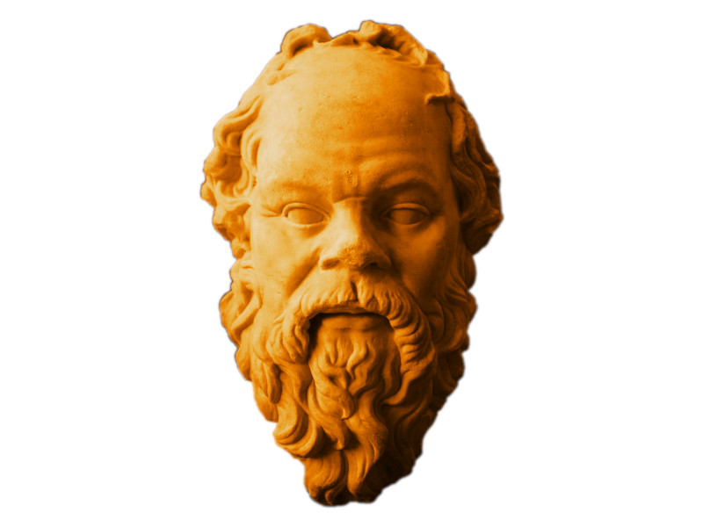
Socrates started Critical Thinking
Don’t trust politicians. They are often confused and irrational people.
Ask questions & search for evidence.
Demand clarity & logic.

Slide 4
Real Madrid is the best football team in Spain.
Why?
They have the best players in the world.
Who won the last league?
Barca!

Slide 5
Critical thinking is incompatible with:
egocentrism
prejudice

Slide 6
So a great time to use critical thinking is when you detect selfishness and bias in yourself or in others:

Slide 7
Remember your tools are:
FACTS
LOGIC

Slide 8
Example Critical Thinking Role Play
Which restaurant shall we go to?
It’s Friday night and you are with your new university friends and you need to decide on a restaurant for dinner.
Secretly one of you is vegan, one of you is rich and another doesn’t have much money on you.
Complex problem solving
Critical thi.nking
Creativity
https://www.weforum.org/agenda/2016/01/the-10-skills-you-need-to-thrive-in-the-fourth-industrial-revolution/

Slide 9
YOUR PROJECT
In your teams, prepare a scene where one of you has views which are socially unacceptable eg racist or sexist. It could be in a restaurant or other public place.
When your scene is ready, perform it in front of the class. Invite the audience to make observations.

