Slide 1
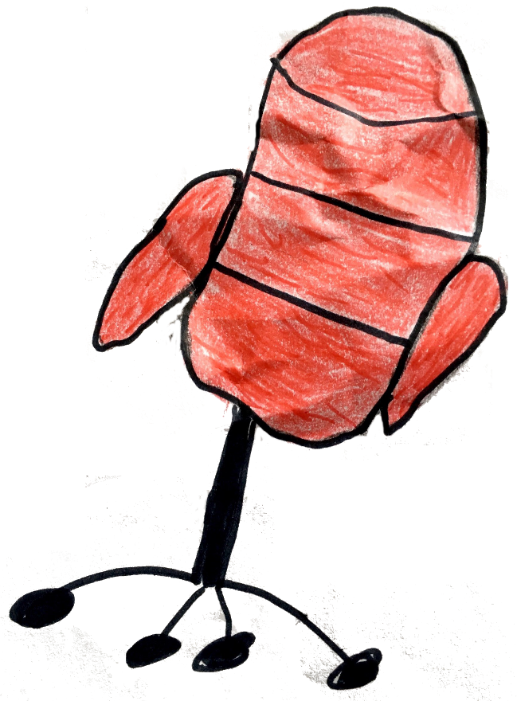
THE HOT SEAT
OR
20 QUESTIONS
for
Wild Animals

Slide 2
crocodile

Slide 3
elephant

Slide 4
flamingo

Slide 5
giraffe

Slide 6
lion

Slide 7
monkey

Slide 8
ostrich

Slide 9
penguin

Slide 10
climb

Slide 11
dive

Slide 12
fly
END FOR 2 PRIMARY

