Slide 1
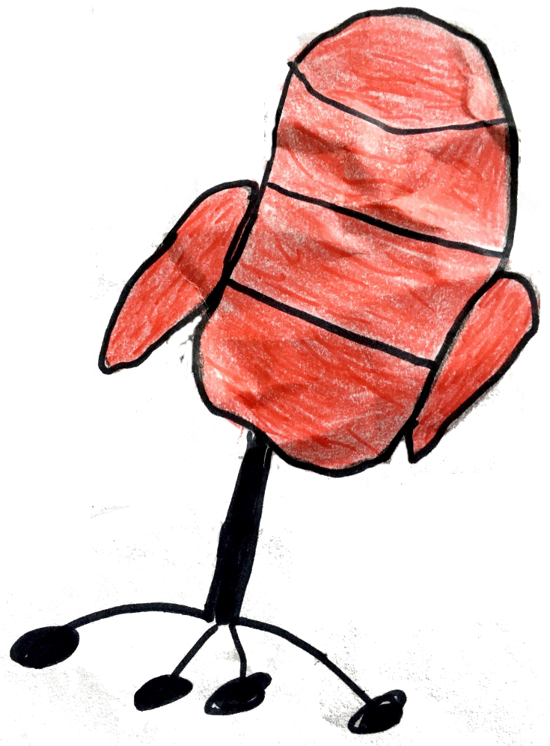
THE HOT SEAT
OR
20 QUESTIONS
for
My Town

Slide 2
cinema

Slide 3
funfair

Slide 4
school

Slide 5
sports centre

Slide 6
square

Slide 7
supermarket

Slide 8
swimming pool

Slide 9
theatre
END FOR 2 PRIMARY

Slide 10
library

Slide 11
shopping centre

Slide 12
park

Slide 13
railway station

Slide 14
town hall

Slide 15
police station

