Slide 1
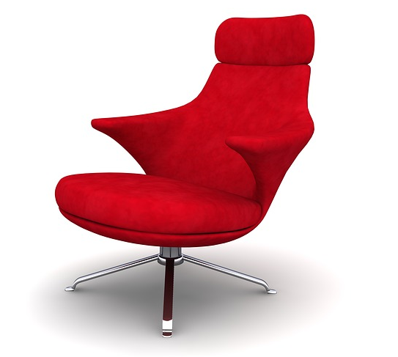
THE HOT SEAT
OR
20 QUESTIONS
for
School
Words

Slide 2
canteen

Slide 3
classroom

Slide 4
gym

Slide 5
library

Slide 6
playground

Slide 7
geography

Slide 8
PE

Slide 9
maths

Slide 10
science

Slide 11
music

Slide 12
drama

Slide 13
English

Slide 14
history

Slide 15
ICT

