Slide 1
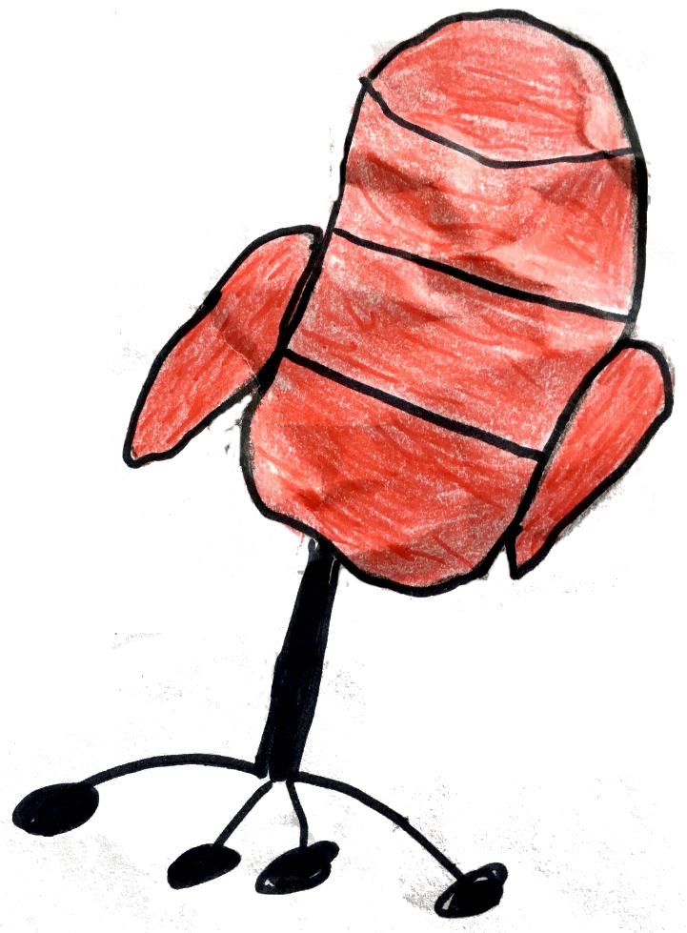
THE HOT SEAT
OR
20 QUESTIONS
for
Hobbies

Slide 2
do sports

Slide 3
go on excursions

Slide 4
listen to music

Slide 5
paint pictures

Slide 6
take photos

Slide 7
watch films

Slide 8
play games

Slide 9
use a computer

