Slide 1
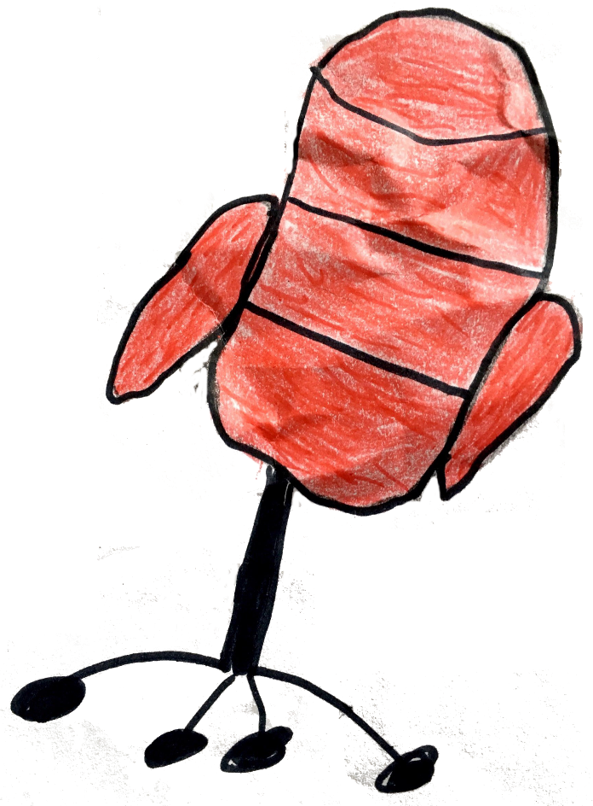
THE HOT SEAT
OR
20 QUESTIONS
for CLOTHES

Slide 2
T-shirt

Slide 3
skirt

Slide 4
jeans

Slide 5
jumper

Slide 6
socks

Slide 7
shirt

Slide 8
hat

Slide 9
trainers

Slide 10
shoes

Slide 11
dress

Slide 12
scarf

