Slide 1
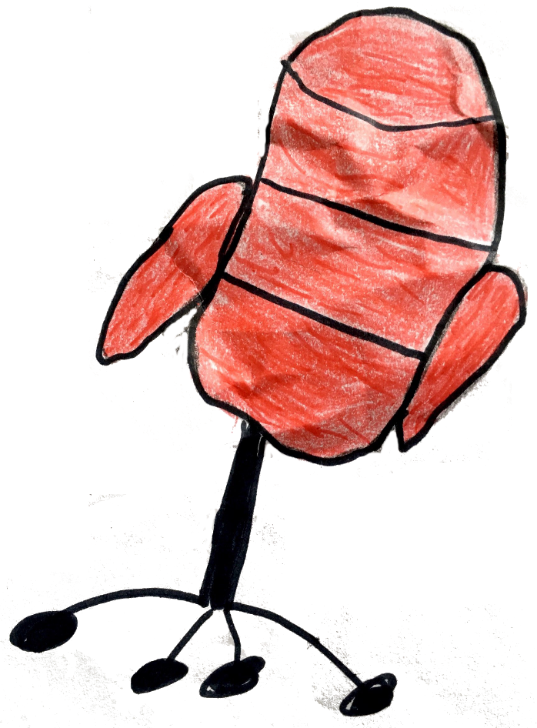
THE HOT SEAT
OR
20 QUESTIONS
for SIX FAIRY TALES

Slide 2
The Gingerbread Man

Slide 3
Goldilocks

Slide 4
The Fox

Slide 5
The Giraffe

Slide 6
Turnip

Slide 7
A pea

Slide 8
A goat

Slide 9
A princess

Slide 10
a queen

Slide 11
an old man

Slide 12
a bear

